Slide 1

Binary

Slide 2
Binary
Recap:
Denary
Binary
Bit (Binary digit)
Byte
Kilobyte

Slide 3
Binary
Recap:
Denary | Our base 10 counting system
Binary | A base 2 counting system
Bit (Binary digit) | The smallest possible storage area for data. Can only be 1 or 0
Byte | A group of 8 bits
Kilobyte | 1024 bytes

Slide 4
Binary
Recap:
The value of each bit doubles from right to left:
x2
x2
x2
128 | 64 | 32 | 16 | 8 | 4 | 2 | 1

Slide 5
Binary
Recap:
The number 5 represented in binary:
128 | 64 | 32 | 16 | 8 | 4 | 2 | 1
0 | 0 | 0 | 0 | 0 | 1 | 0 | 1
4
+
1
= 5

Slide 6
Binary
Convert the binary numbers into denary:
Binary | Denary
OOOOOOO1
OOOOOO1O
OOOOOO11
OOOOO1OO
OOOO1111
11111111

Slide 7
Binary
Convert the binary numbers into denary:
Binary | Denary
OOOOOOO1 | 1
OOOOOO1O | 2
OOOOOO11 | 3
OOOOO1OO | 4
OOOO1111 | 15
11111111 | 255

Slide 8
Binary
Convert the denary numbers into binary:
Denary | Binary
128
64
127

Slide 9
Binary
Convert the denary numbers into binary:
Denary | Binary
128 | 1OOOOOOO
64 | O1OOOOOO
127 | O1111111

Slide 10
Binary
ASCII
(American Standard Code for Information Interchange)
When we type on the keyboard, each character (letter, number and symbol) gets converted into an ASCII code. This is then converted to binary by the computer.

Slide 11
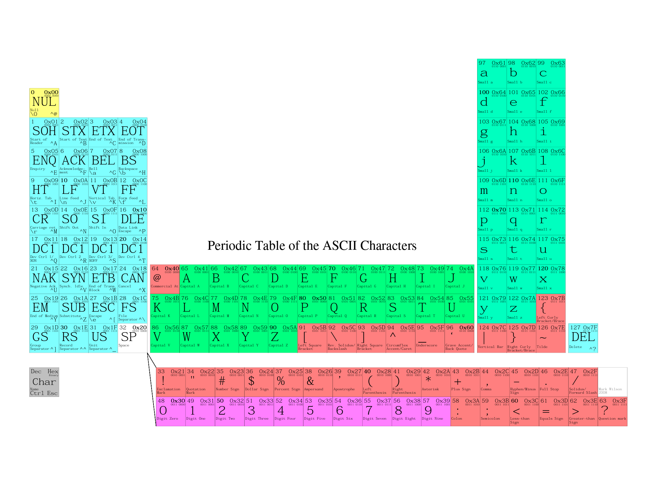
Binary
From: http://www.funnypolynomial.com/misc/creative/periodicASCII.pdf

Slide 12
Binary
Each character you type has a code number associated with it.
This code number can be
represented in decimal or binary.

Slide 13
Binary
Using the ASCII table, can you
decode this binary message?
01000010 01101001 01101110
01100001 01110010 01111001

Slide 14
Binary
01000010 = B
01101001 = i
01101110 = n
01100001 = a
01110010 = r
01111001 = y

Slide 15
Binary
This is quite cumbersome for long messages...
010000100110100101101110011000010111001001111001 01100011011011110110010001100101 0110100101110011 0111001101101001011000110110101100100001

Slide 16
Binary
...so, we can represent binary using hexadecimal.
O1OO | OO1O | B
4 | 2
O11O | 1OO1 | i
6 | 9
Using this method, each byte can be represented by
two hexadecimal numbers.

Slide 17
Binary
But, what about numbers greater than 9?
How can we represent those using one digit?
O1OO | OO1O | B
4 | 2
O11O | 1OO1 | i
6 | 9
O11O | 111O | n
6 | ???

Slide 18
Binary
Decimal vs Hexadecimal
Dec | 15 | 14 | 13 | 12 | 11 | 10 | 9 | 8 | 7 | 6 | 5 | 4 | 3 | 2 | 1 | 0
Hex | F | E | D | C | B | A | 9 | 8 | 7 | 6 | 5 | 4 | 3 | 2 | 1 | 0

Slide 19
Binary
O1OO | OO1O | B
4 | 2
O11O | 1OO1 | i
6 | 9
O11O | 111O | n
6 | E
O11O | OOO1 | a
6 | 1
O111 | OO1O | r
7 | 2
O111 | 1OO1 | y
7 | 9

Slide 20
Binary
The word "Binary" = 42 69 6e 61 72 79
in hexadecimal.
To denote a hexadecimal number,
we often use the prefix 0x.

Slide 21
Binary
For example, the capital letter P is coded as 80 in decimal or 01010000 in binary...
...and also 0x50 in hexadecimal.

Slide 22
Binary
Using the ASCII table,
can you decode this hexadecimal message?
42 69 6e 61 72 79
69 73
73 69 06 30 6b 21

Slide 23
Binary
Can you convert your name into binary or
hexadecimal using the ASCII table?

Slide 24
Binary
In pairs, create a secret binary or hexadecimal message
and send it to your partner to decode.

Slide 25
Binary
Can you decode these factoids from binary into decimal?
A man named Michael Lotito ate 00010010 bicycles in his life.
There are 00000101 babies born every second.
The word ‘hundred’ derives from ‘hundra’ in Old Norse, which originally meant 01111000.
Dr Seuss' book, Green Eggs and Ham, contains only 00110010 different words.

Slide 26
Binary
Answers:
A man named Michael Lotito ate 00010010 bicycles in his life. | 18
There are 00000101 babies born every second. | 5
The word ‘hundred’ derives from ‘hundra’ in Old Norse, which originally meant 01111000. | 120
Dr Seuss' book, Green Eggs and Ham, contains only 00110010 different words. | 50

Slide 27
Binary

